Slide 1
Application of Perceiver IO Network to Abdominal Multi-Class, Multi-Modality Medical Image Segmentation
Jim Carty
Notes:
Hello my name is Jim Carty and this presentation is about my Bachelor’s project titled the “Application of the Percevier IO network to abdominal multi-class, multi-modality medical image segmetnation.

Slide 2
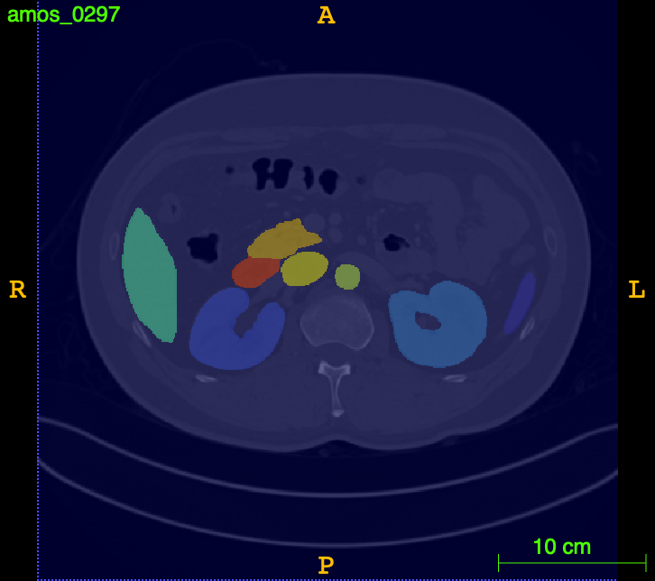
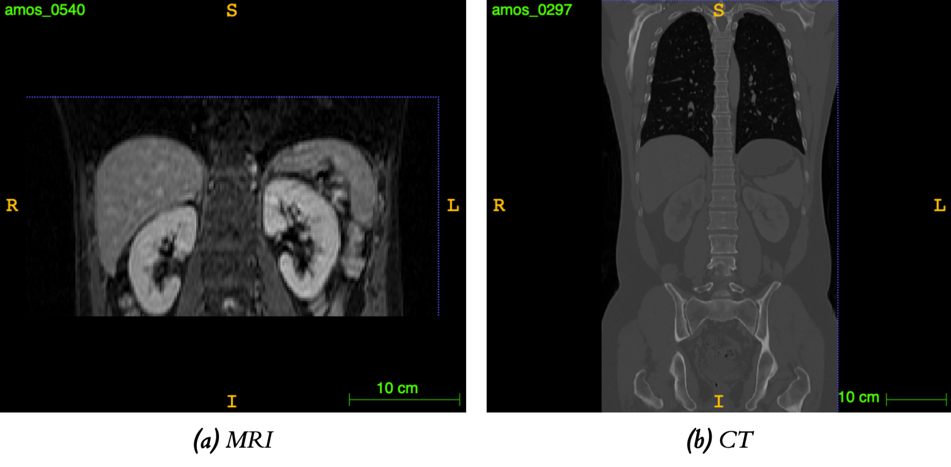
Introduction: Why?
Analysing segmentations is the first step towards diagnosis and treatment
They are very costly to produce
Automating this process would be incredibly beneficial
Generalisability is imperative for deployment
Notes:
Analysing segmentations is the first step towards diagnosis and treatment as it allows for many metrics and conclusions to be calculated and made based on an organs locations and properties.
These are however very costly to produce as they must be created by highly-trained physicians and can take a long time to produce accurately.
As such, automating the creation of medical image segmentations would be incredibly beneficial as it would not only speed up diagnoses and treatment of patients, but would also help to elliviate some of the work that medical professionals have to complete.
Furthermore, with the utilisation of several different modalities in modern times, as seen in the bottom image, many different images can be created. These can differ in intensity value, resolutions, and in the region of the body imaged. As such, creating bespoke systems for every image property and modality is infeasible. This makes finding a generalisable solution imperative to guarantee deployability and usability of such automated systems.

Slide 3
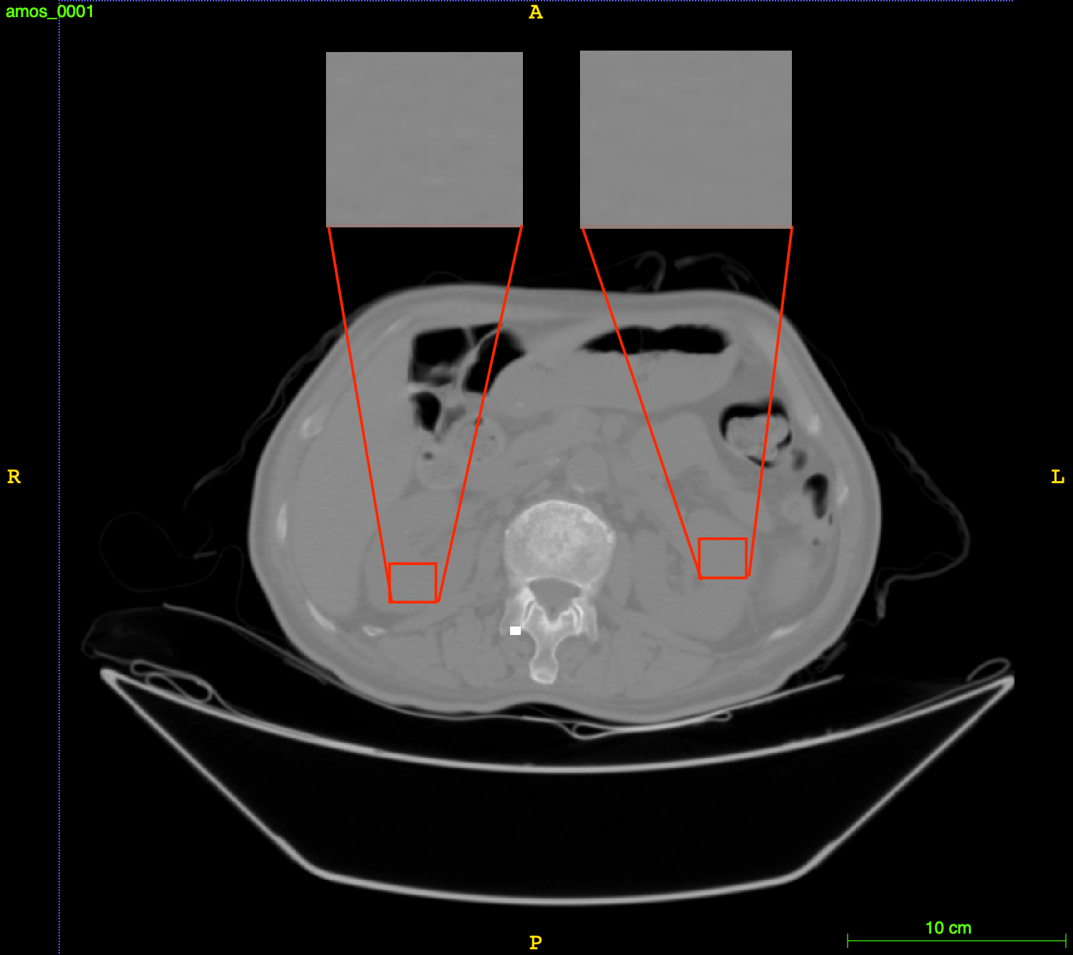
Background: Classical Approaches
Initially, this seems simple
Should be able to multi-threshold the image or use a technique like k-means clustering
Classical techniques perform poorly in practice
Particularly susceptible to noise
Notes:
First, some background on research conducted already.
Initially the challenge of medical image segmentations seems simple. We have access to a highly accurate, grey scale images - we could simply code in different thresholds that will classify pixels with similar intensities as the same class.
Due to their simplicity, these approaches have been found to be rather inaccurate in the cases of image noise. However, their greatest failing is shown when considering that entirely separate organs can have very similar densities. For example, the left and right kidneys shown in the accompanying picture.

Slide 4
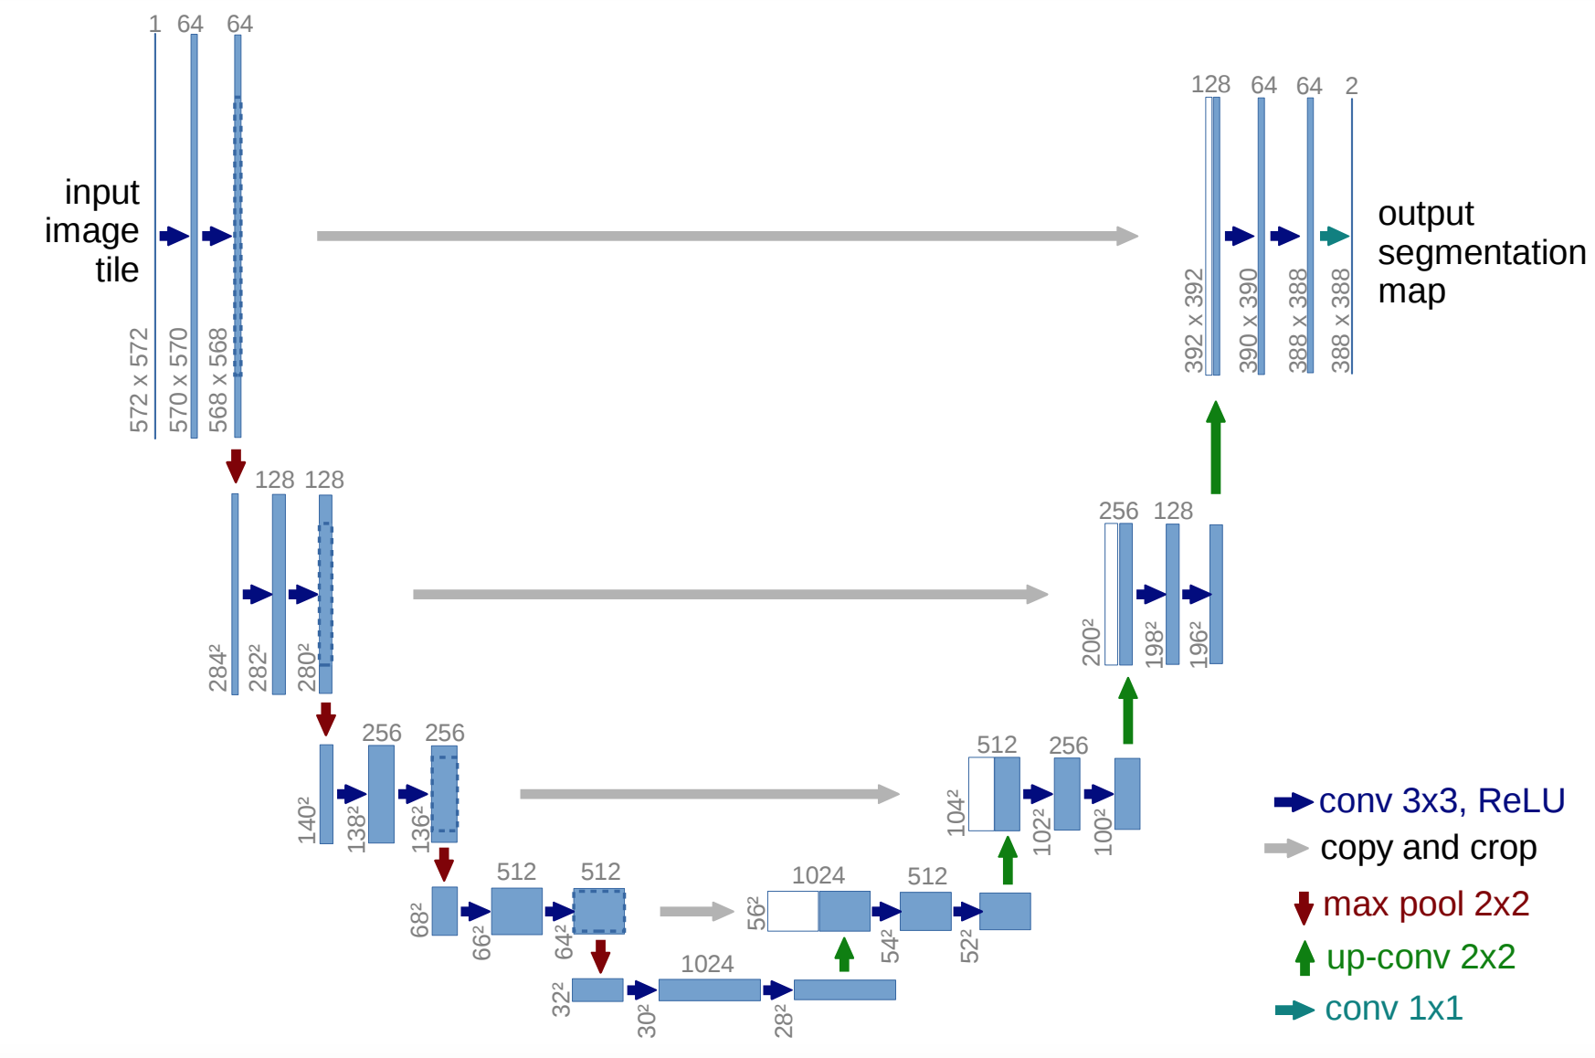
Background: Convolutional Neural Networks
More generalisable and intelligent solutions needed
CNNs have proven success in computer vision field
Utilised in biomedical segmentation in the form of the U-Net architecture
Impressive accuracy when inferencing
Diagram from “U-net: Convolutional networks for biomedical image segmentation”
Notes:
As such, a more intelligent solution has to be used. In the field of computer vision, neural networks models based on convolutions of the input signal have been found to be incredibly successful in performing complex tasks, such as bounding box detection.
These style of networks have gained a foothold in medical image segmetnation most notably with the U-Net architecture. This architecture describes and autoencoder-style network using convolutions to down and up sample the image. To persist image data throughout the network and build up contextual information, it also makes use of skip connections that concatentate data from the encoder’s levels to decoder’s levels.

Slide 5
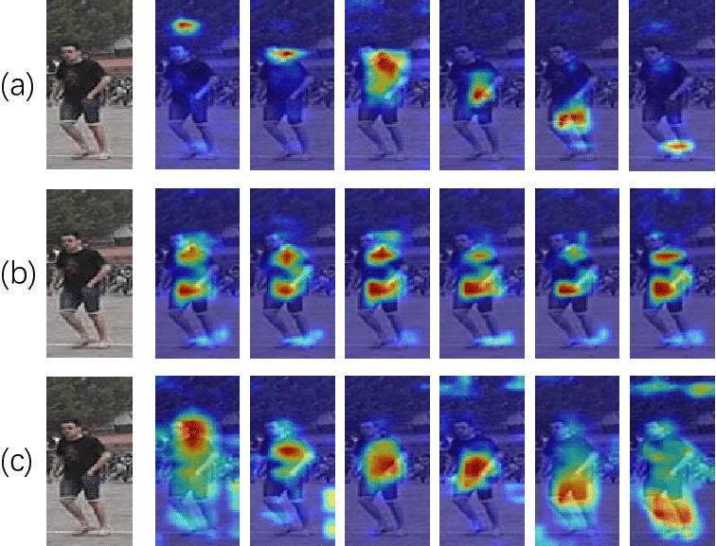
Background: Spatial Awareness
Due to the nature of convolutions, the U-Net architecture cannot consider long-range spatial dependencies
Multiple extensions to allow it to do so: e.g recursion and attention maps
Proven to improve the performance of U-Net
Diagram from “Multi-Task Learning With Coarse Priors for Robust Part-Aware Person Re-Identification”
Notes:
However, due to the nature of convolutions, the U-Net architecture is unable to form long-range spatial awareness. This limits its capabilities making it susceptible to misclassifications such as in the case of left and right kidneys.
To remedy this, multiple extensions have been integrated with the U-Net model to allow it to consider more spatial and contextual information. One such method, the use of attentions-maps first creates a heat map of the image, then allows the U-Net to process it. These techniques have been found to greatly help the model’s performance

Slide 6
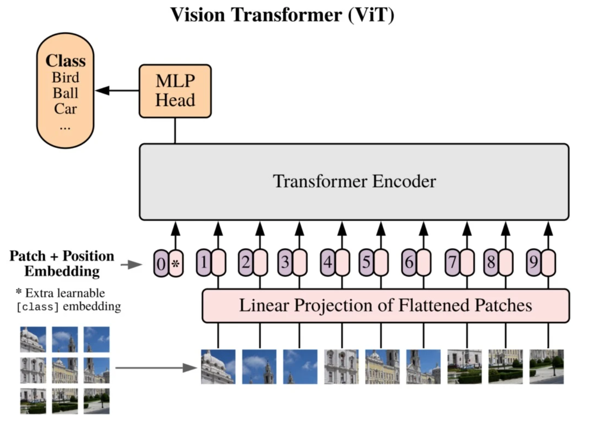
Background: Transformers
Introduces the concept of making the inputs attend to themselves
Operates by building up latent representations of the inputs, reliant on themself
Successes found seen in NLP and CV
Diagram from “An Image is Worth 16x16 Words: Transformers for Image Recognition at Scale”
Notes:
However, with these many required extensions to CNN-based models, it begs the question of if a new style of neural network architecture could perform equally, if not better.
Transformers are a recent development in machine learning that introduce the concept of self-attention. This allows for network to build up latent representations of the inputs by relating every input to one another. Additionally, transformers produce outputs the same size as their inputs, allowing for transformers to be iteratively applied on prior outputs.
This style of network has been found to be effective in natural language processing tasks with models such as GPT-3. Transformers have also been extended to be able to take in image data, performing computer vision tasks better than CNN-based models.

Slide 7
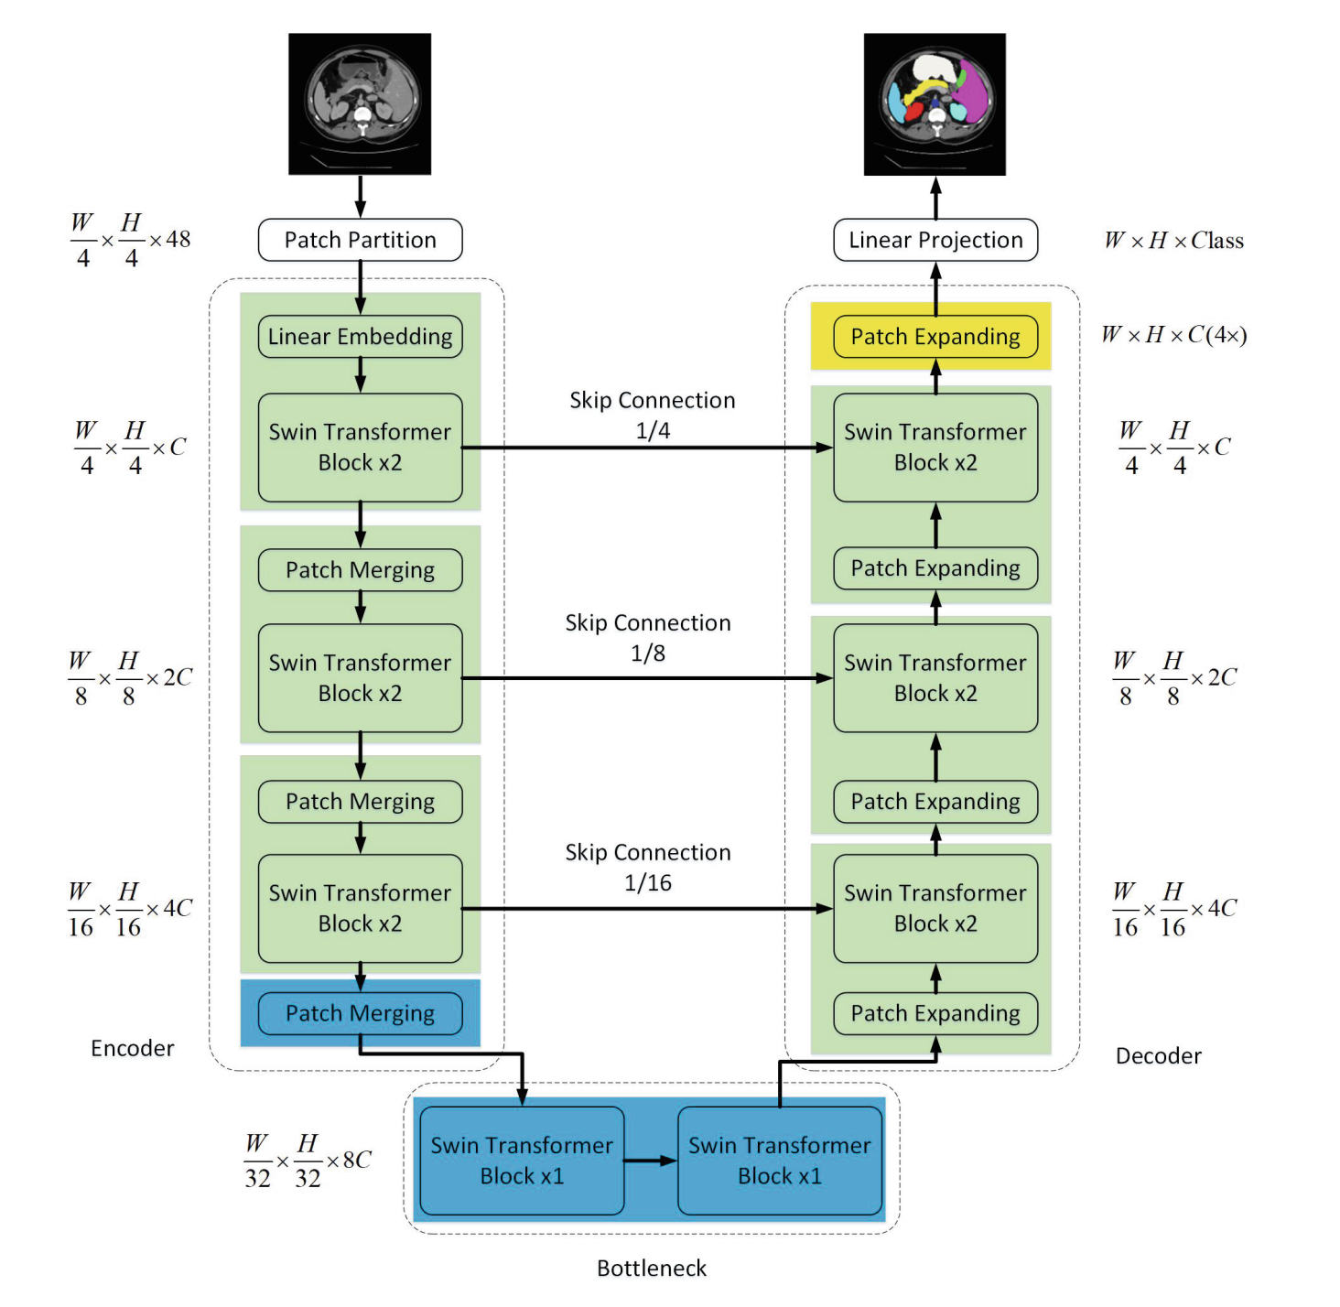
Background: Transformers in Biomedical Segmentation
Successfully applied to biomedical segmentation through U-Net style models
However, more complex networks require more computations
Especially true for transformers
Diagram from “Swin-unet: Unet-like pure transformer for medical image segmentation”
Notes:
In reference to medical image segmentations, transformers have been successfully integrated into the U-Net architecture in several ways. The most notable is the Swin-Unet model that uses hierarchical vision transformers as well as patch merging and expanding layers to take in vast amount of contextual information before computing the output.
Models such as these, however, require vast amounts of computations, limiting the complexity that they can be expanded to and the use cases that can support them.

Slide 8
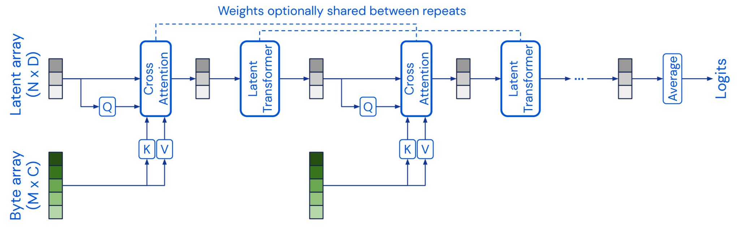
Background: Perceiver
Time complexity largely stems from the quadratic time to compute its self-attentions w.r.t to the inputs - O(LM²)
Perceiver architecture proposed that allows for generalisable linear time complexity w.r.t the inputs - O(MN + LN²)
Uses a independent latent array as transformer layer inputs/outputs
Diagram from “Perceiver: General perception with iterative attention”
Notes:
The greatest hurdle in using transformers is the quadratic time complexity required by the matrix multiplication operations present in its self-attention layers central to it, with respect to the inputs.
To combat this, the Perceiver architecture was put forward that separates the inputs from the transformers. This model relies on a latent array, whose size is a hyperparmaeter, to be propagated throughout the transformers layers instead of the input array. The input array is instead merged with the latent array in a cross-attention layer. This results in a time complexity linear with respect to the inputs.
This allows for more transformer layers to be stacked, allowing for deeper and more expressive latent representations of the inputs to be formed.

Slide 9
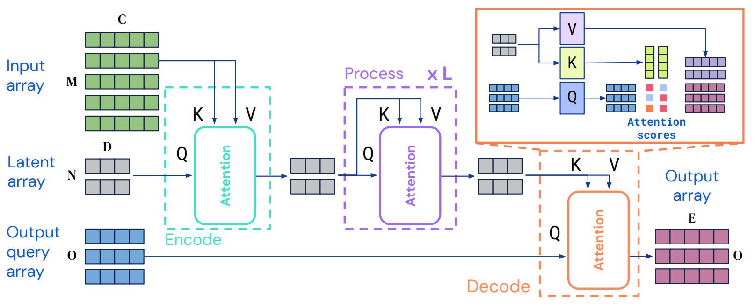
Background: Perceiver IO
Perceiver architecture only allows for results aggregated from the latent array
Segmentations require outputs at least of the inputted scan
Perceiver IO describes an encode, process, decode architecture to allow for genetically sized inputs and outputs
Diagram from “Perceiver IO: A general architecture for structured inputs & outputs”
Notes:
The initial Perceiver architecture only outputted results with the same size as the latent array, only allowing agregations of the data to be outputted and used. This is not useful for medical image segmentations as the results are commonly the same size as the inputs.
To allow for generic input and output arrays, the Perceiver IO architecture was put forward, making use of additional cross-attention layers in an encode-process-decode process.

Slide 10
Requirements: Based on the Background…
Can process long-range spatial and contextual information
Uses a deep transformer-style network
Is generalisable to multiple modalities
Computations do not increase drastically with modern, high-resolution scans
Notes:
From this background information, we produced a list of requirements that we want our solution to achieve. We want it process long-range spatial and contextual information, use a deep transformer-style network, be generalisable to multiple modalities, and for computations to not increase drastically with modern, high-resolution scans. As seen earlier, all of these issues can be solved by the Perceiver IO architecture.

Slide 11
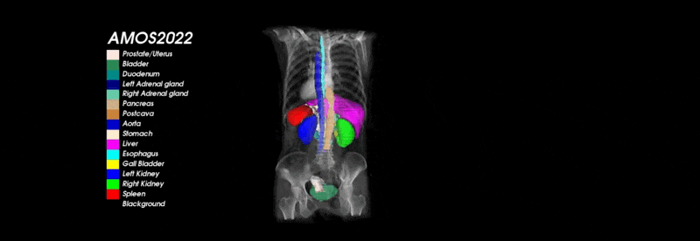
Requirements: Contributions of the Project
To novelly apply the Perceiver IO architecture to biomedical image segmentations
Evaluate this application’s effectiveness and generalisability compared to the state-of-the-art using an public, online leaderboard - AMOS22 challenge
Visualisation from “Multi-Modality Abdominal Multi-Organ Segmentation Challenge 2022”
Notes:
As such, the contributions of this project are that we will novelly apply the Perceiver IO architecture to the creation of medical image segmentations. Additionally, we will evaluate the architecture and generalisability against state-of-the-art models.
We chose to conduct this comparison using an online leaderboard. Specifically, we chose to the 2022 Abdominal Multi-Organ Segmentation challenges leaderboard and dataset to conduct the model training and evaluation on.

Slide 12
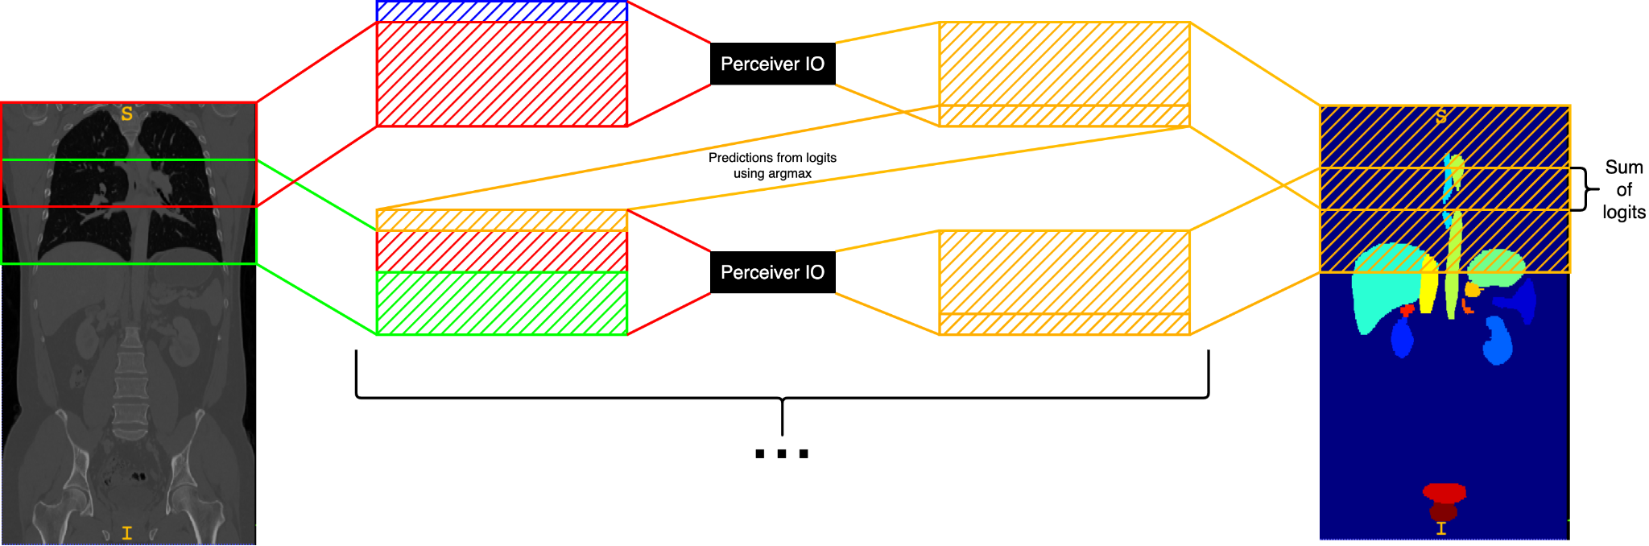
Perceiver IO: Design
Scans processed in multiple slabs, due to their size
Recurrent slices used to increase inter-slab dependency and attention
Overlapping slices used to decrease noise around label edges
Notes:
Due to the amount of data in each scan, scans were inference in slabs. As this would decrease how much the networks can attend to the full scan, recursive outputs from previous inferences were stacked on top of the current data to allow for inter-slab dependencies to be built up, similar to the recursion used by U-Net architectures.
Additionally, noise was seen around labels edges during early prototyping stages. To counteract this, overlapping slices were used, where each slab would overlap the last slightly. These techniques can be seen in the attached image where blue represents a full zero tensor as the first recursive input.

Slide 13
Perceiver IO: Implementation
Based off of a fork of an implementation of the general architecture
Utilises PyTorch Lightning to perform training and maintain separation of datasets
Extended implemented models to include segmentation-specific features
Notes:
To avoid having to implement and test the Perceiver IO architecture, a ready-made implementation was forked from GitHub. This repository used PyTorch Lightning to perform the training operations on the models. Additionally, Lightning strictly adhered to the standard uses of train-test and validation datasets, helping to prevent unnoticed overfitting and make evaluated results valid.
The original implementation was also extended to include a new segmentation module definition with the described segmentation-specifc features and scripts for all evaluation and training tasks.

Slide 14
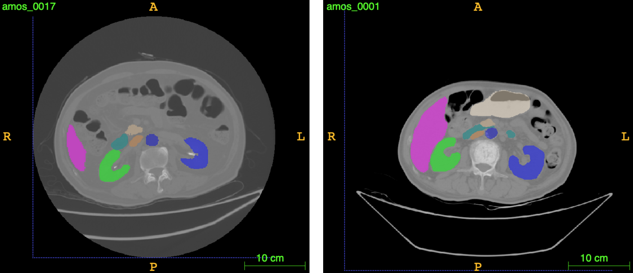
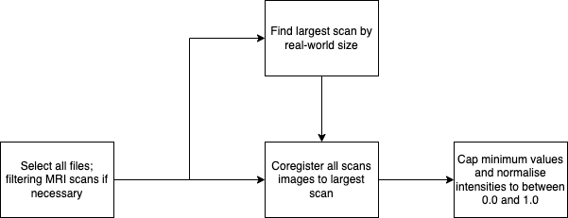
Dataset Processing: Design
AMOS dataset consists of raw CT and MRI scans
Must be preprocessed to form meaningful relations when training
Done by coregistering all scans to the largest, and normalising intensities
Notes:
The AMOS dataset consists of a zip file containing several hundred unprocessed CT and MRI scans in NIFTI format. As such, these scans vastly varied in several ways, most critical of all was that patient orrientation and organ location. This variation can be seen with the left and right leans in the included scans.
To allow for the moel to form meaningful relationships in the data and produce high quality segmentations, these scans had to be transformed to all be in the same format. This was done by coregistering the scans. Additionally, itensitiies were capped and normalised to minimise intensity variation. The full preprocessing pipeline can be seen in the flow chart.

Slide 15
Dataset Processing: Implementation
Integration with Perceiver IO model required building a custom data loading class
Built using abstract Lightning classes to allow for the correct dataset splitting
Coregistred scans were cached to dataset folder to speed up development and training times
Notes:
Due to the raw nature of the AMOS dataset, a Lightning Data module class was implemented. This class provided data loaders for each dataset from set functions.
Coregistration was implemented using the SimpleITK library’s ImageRegistrationMethod, initialised to perform gradient descent three times on each pair of scans for 500 iterations with a learning rate of 2.0. This took around 15 seconds to compute for each scan, so to save time during development and repeated training, these preprocessed scans were saved to a directory in the amos folder.

Slide 16
Parameter Optimisation: Design
Required to fairly compare Perceiver IO model to the literature
Many parameters to tune, for Perceiver IO and additional extensions for segmentation
Suspected logarithmic increase to all parameters, however, at different rates
Notes:
To fairly compare the Perceiver IO to the literature, its parameters had to be optimised to allow it perform as well as possible.
Due to the complexity of the model and its integration with segmentation data, there were many parameters to tune.
We suspected that each increase in a parameter’s value would improve the model trained, however, we also believed that each parameter would improve the model at a different rate. Additionally, since the model was to be trained on the GPU - to make training viable - there was a hard limit on how complex the model could be. As such, if two models with different parameter sets both filled the memory available, one would likely perform better than another.

Slide 17
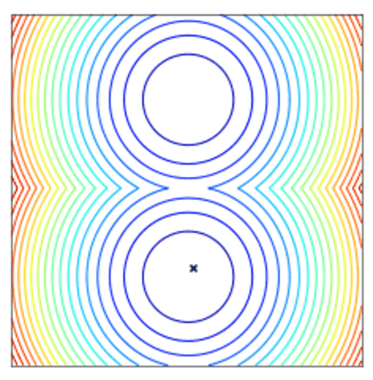
Parameter Optimisation: Implementation
Due to non-convexivity of hyperparameter spaces, gradient-based approaches can be ineffective
As such, the derivative-free Nevergrad optimiser was used
Relies on an adaptive optimiser that provides a recommendation after fulfilling its budget
Visualisation from “Nevergrad - A gradient-free optimization platform”
Notes:
This vastly complicated the parameter space. To help to automate the exploration adn refinement process, we determined that we should use an optimisation algorithm.
Due to the hyperparameter spaces such as this commonly having a non-convex shape, gradient-based approaches are were likely to fail. Additionally, there would be an additional memory requirement to store the gradients, decreasing the size of the possible models that could be optimised for. As such, we looked to use a derivative-free approach. These approaches, however, often suffer from exponential time complexity or an entire naivety of the parameter space’s shape. As such, we decided to use an adaptive probability-based optimiser called Nevergrad to perform the optimisation. This optimiser relies on a budget to optimise within, solving the exponential and uninformed issues present in other derivative-free optimisers.

Slide 18
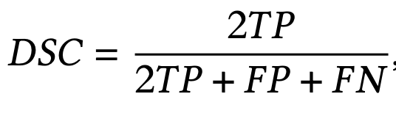
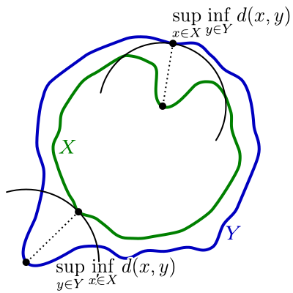
Evaluation: Metrics
Marco-averaged Dice coefficient (DSC) for describing the accuracy of the model
Macro-averaged Hausdorff distance (HD) for describing the accuracy of the edges of the labels
Diagram from Hausdorff Distance” on Wikipedia
Notes:
When evaluating the model, two metrics were used. The macro-averaged dice coefficient, which describes the accuracy of the labels by the proportion of the true positive labels against the true positive and false labels. This metric is also commonly used in the literature, and even the AMOS online leaderboard for ranking models.
The Hausdorff distance was also used to help evaluate the model’s ability to accurately predict the edges of the segmentations. This is done by finding the largest distance between a point on one label’s edge and the closest point on the other label’s edge.

Slide 19
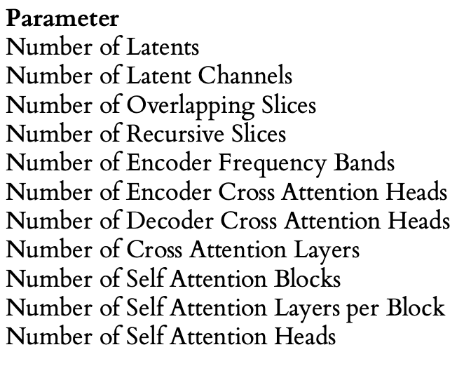
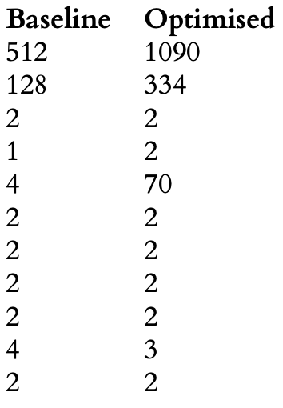
Evaluation: Parameter Optimisation
Given a budget of 50 and with 20 training epochs for each model, validation loss decreased by 49%
Performance did not translate to improvements in accuracy when fully trained for 350 epochs
Increased parameters and inference time by 1.2 million and 145%
Not used for further training, however, shows effectiveness
Notes:
For the parameter optimisation experiment, the optimiser was given a budget of 50. The models were also allowed to train for 20 epochs. From this, the optimiser was able to decrease the loss by 49% in comparison to the baseline model. However, this did not translate to an overall performance increase when fully trained to convergence at 350 epochs.
Additionally, the optimised model had an additional 1.2 million parameters and a 145% increase in the inferences time. As such, we decided that the parameter optimised model should not be used for further training as it gives little overall improvement.

Slide 20
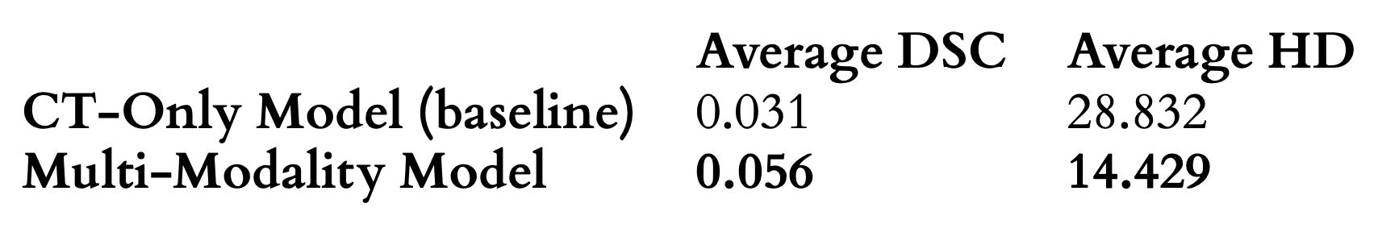
Evaluation: Multi-Modality Generalisability
Found to greatly improve both DSC and HD metrics when fully trained for 350 epochs
Likely due to more data available for training
Still shows improvement and effective generalisation
Recommended for further use and shows that Perceiver IO generalises to multi-modality data well
Notes:
When fully training the baseline model on CT-only and CT plus MRI data, we found that the multi-modality trained model far outperformed the CT-only model. We believe that this may be due to the model having more data to train with, 168 scans instead of 140, however, it still shows that the Perceiver model can effectively generalise to multiple modalities.
As such, we can recommend its continued use.

Slide 21
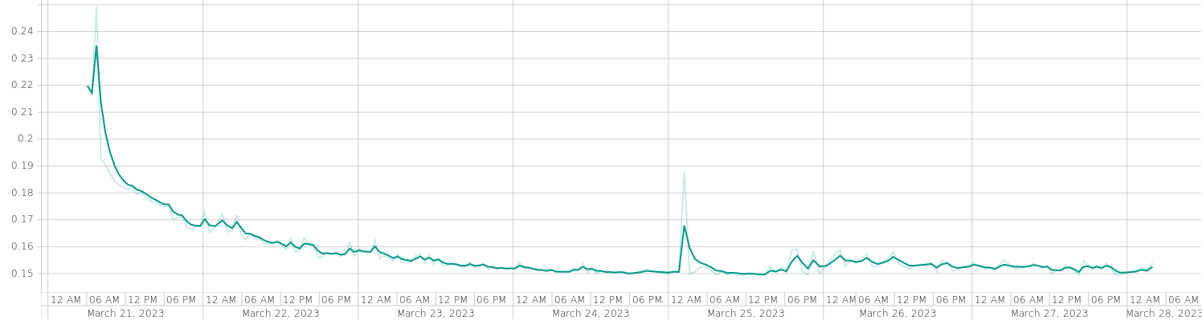
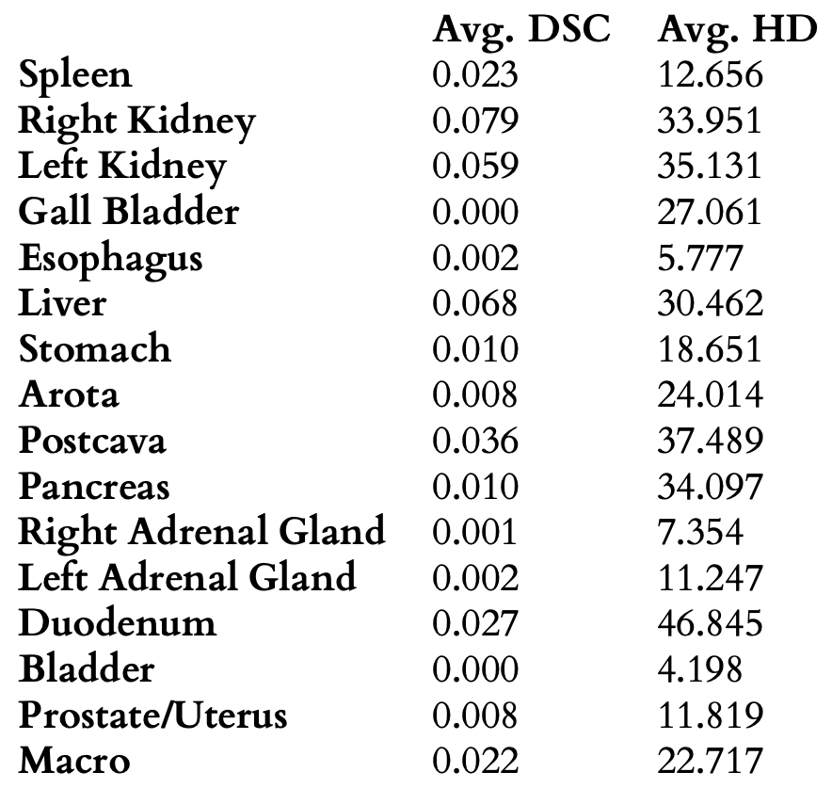
Evaluation: Full-Scan Inference
Used baseline parameter and multi-modality data
Trained until it appeared to converge; 212 epochs
Submitted to AMOS leaderboard, placing third/last
Cannot recommend continued use of Perceiver IO currently
Notes:
From these findings, we were able to determine the parameters to train a full-scan model on. This was only done once due to the immense number computations requiring multiple days to train. Due to this, the model was only trained until it appeared to have converged on a validation loss value, at 212 epochs. This model’s results for the AMOS test set was submitted to the leaderboard, placing last.
As such, we cannot recommend the continued use of the Perceiver network in this state.

Slide 22
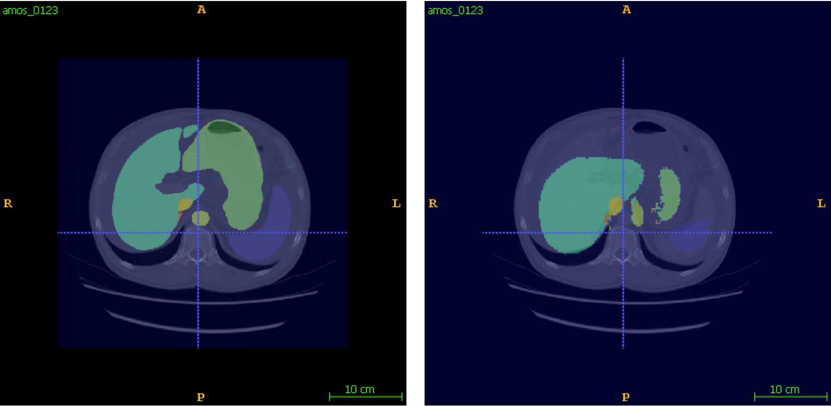
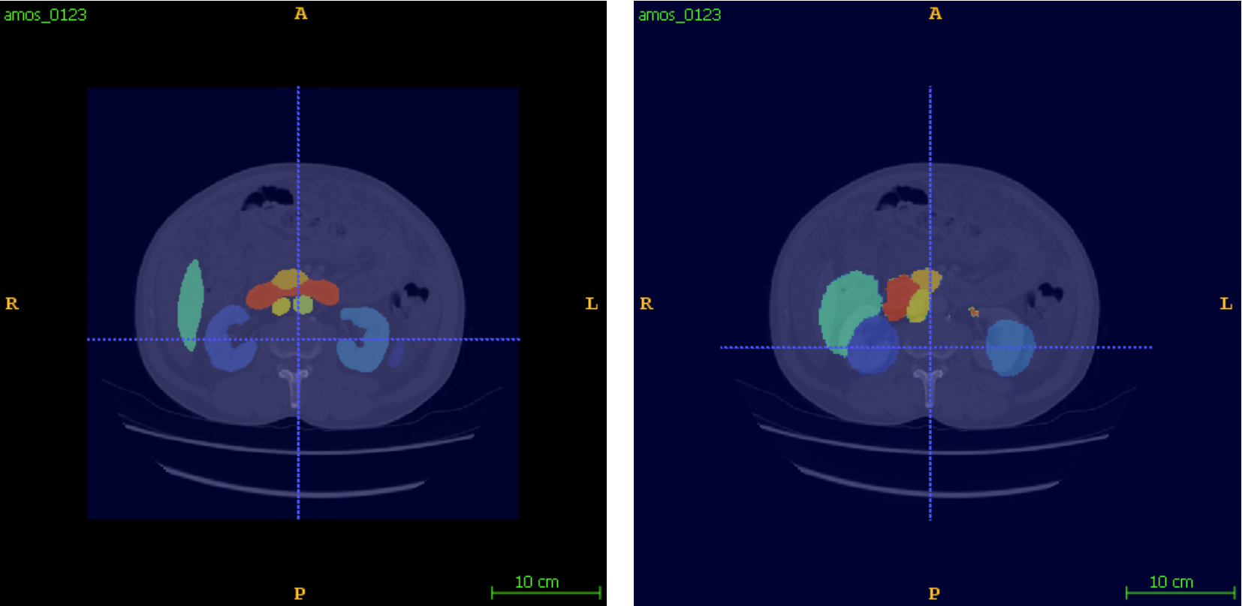
Evaluation: Full-Scan Inference
Ground-truth and inferred labels centered on the liver and stomach
Ground-truth and inferred labels centered on the kidneys
Notes:
This slide shows some example segmentations generated by the trained model.

Slide 23
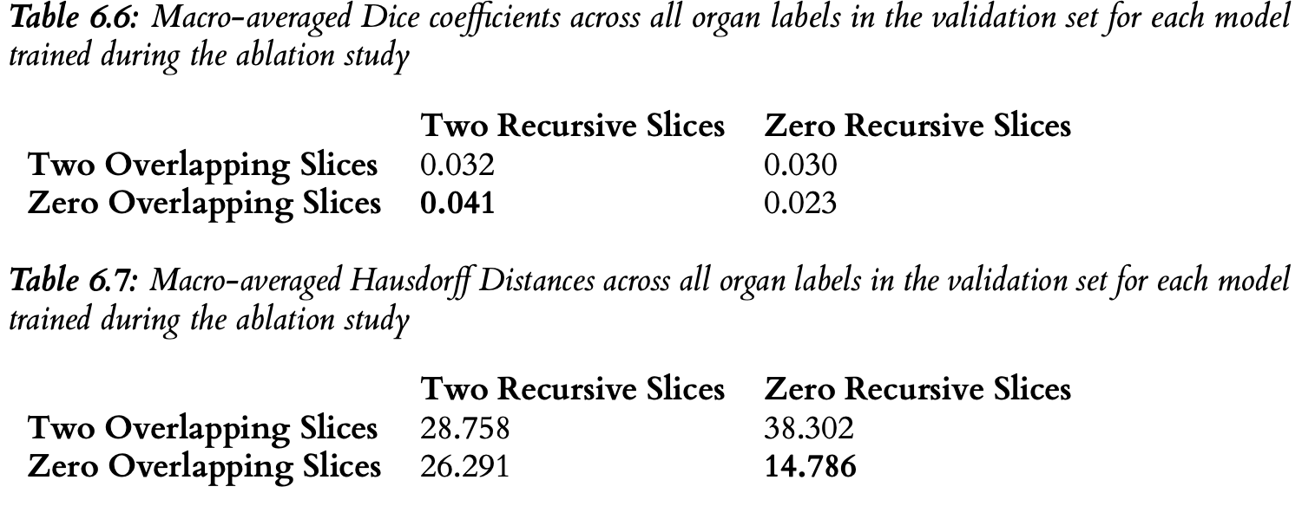
Evaluation: Ablation Studies
Performed on recursive and overlapping slices
Punnett square of models and metrics computed after training for 350 epochs using baseline parameters
Recursive shown to improve DSC by up to 177%; Overlapping shown to improve HD, as intended
Would recommend continued use of recursion, not of overlapping currently
Notes:
Ablation studies were also conducted on the segmentation-specific integrations. Forming a punnett square for the results, we can see that recursive scans improved the model’s effectiveness by up to 177%, and that the overlapping model decreased the hausdorff distance as intended. However, the overlapping slice’s decrease was at the detriment of the overall accuracy and increased inference times.
As such, we would recommend the continued use of recursive inferences, however, not of overlapping in its current state.

Slide 24
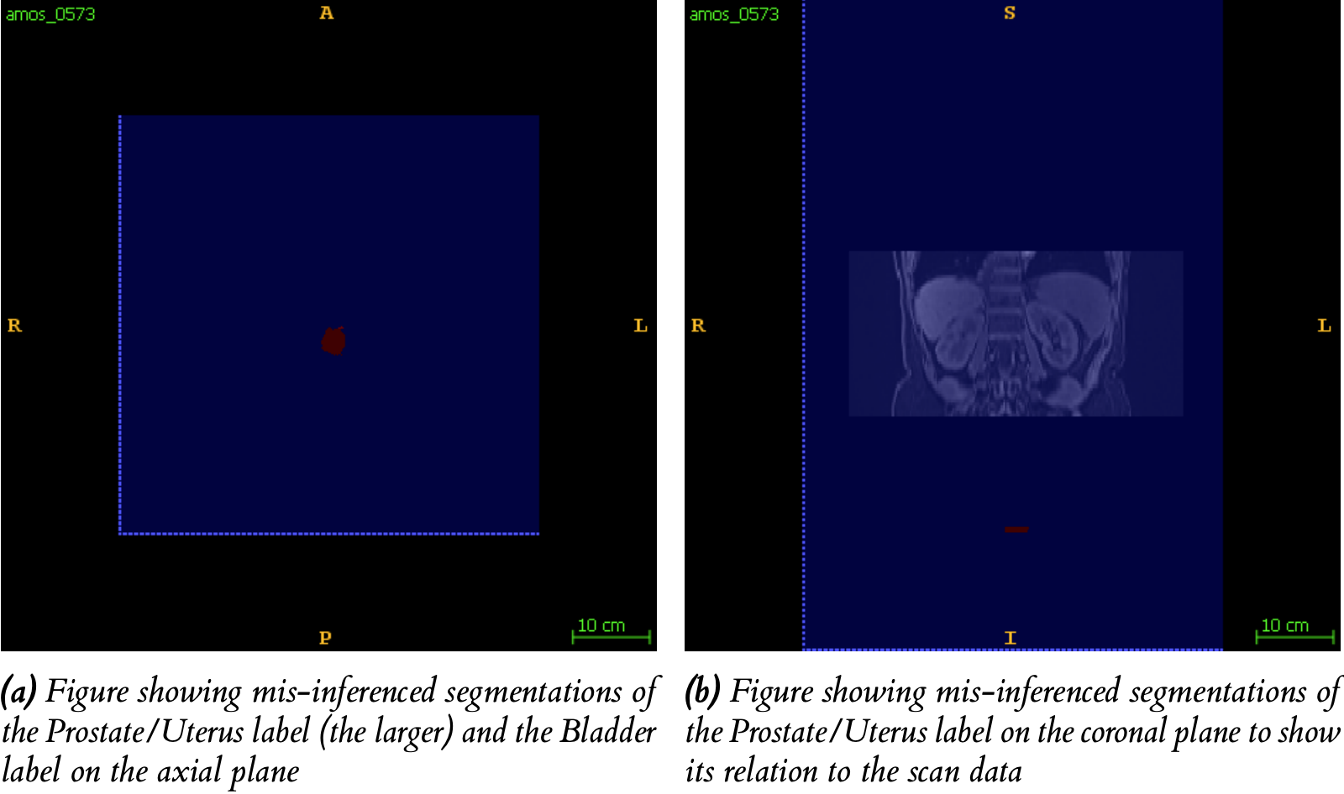
Evaluation: Additional Observations
Perceiver IO found to still infer labels without presence of input data
Labels are commonly in correct locations
Possibly shows that Perceiver network is learning the natural and probable topology of humans
Notes:
Additionally, we saw that the full-scan model would mis-inference labels commonly. This was commonly done in the presence of data, however, more interestingly, also without data. This can be seen in attached image, where the prostate/uterus and bladder labels are predicted, despite having no surrounding i.e input data. Furthermore, we saw that these labels appear in largely the correct location, suggesting that the Perceiver model is able to learn the natural and probable morphological topologies of the human body based on the little data it was trained on.

Slide 25
Conclusions
The Perceiver IO architecture is receptive to novel extensions and parameter optimisations
It is also capable of creating meaningful segmentations and powerful latent representations of the human body
Not effective as a standalone system for the task
This paper is a successful exploratory work, confirming the need to investigate Perceiver IO further
Notes:
Overall, we have found the Perceiver network to be receptive to novel extensions and optimisations, and that it can create meaningful segmentations using a powerful latent representation of the human body.
However, the network is not effective as a standalone system. We do however see this paper being a successful exploratory work, emphasising that the perceiver network should be investigated further to determine the full extent of its capabilities.

Slide 26
Future Work
The areas that could be further investigated based on this paper include:
Building hierarchical Perceiver IO modules, as seen in Swin-UNet
Integrating Perceiver IO with U-Net - generic outputs would allow for a complete persistence of latent representations i.e without the need additional steps between layers
Performing further studies on U-Net style extensions, such as per-level recursion on the Perceiver IO U-Net
Training and use of a second averserial model to reject inauthentic segmentations
Further extensions to biomedical image preprocessing to make up for the scarcity of data
Notes:
As such, we see there being many opportunities for future work, included in this final slide. Such opportunities include development following on from vision transformers including; evaluating hierarchical perceiver modules, integrating with the U-Net architecture, and experimenting with exisiting U-Net extensions. Additionally, the use of adversarial models to refine segmentations maps further can be investigated. Also, better preprocessing pipelines of medical images to possibly create multiple training images from one image can be explored.

